Slide 1
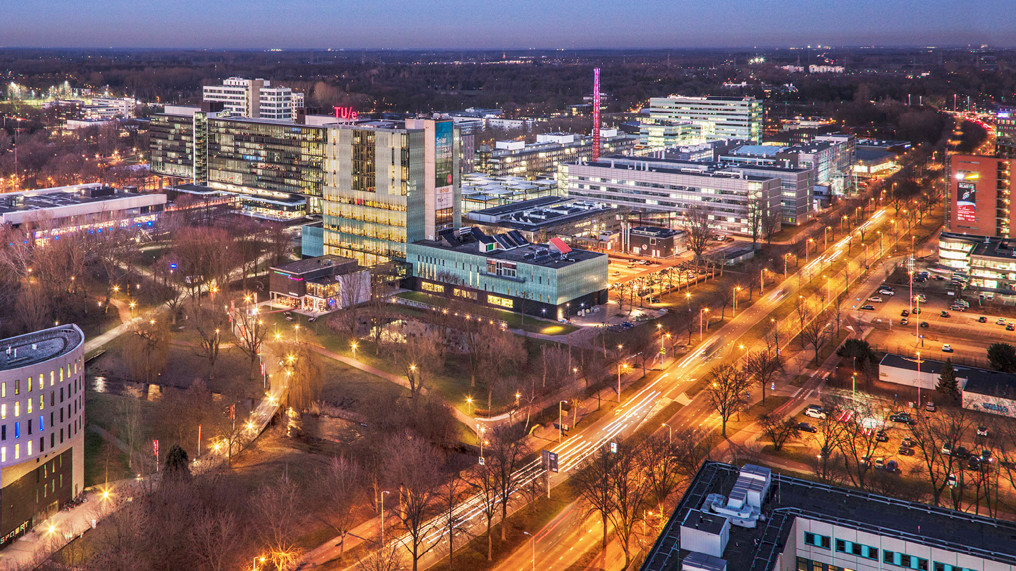
2021 AutoRef – Meeting III
Friday, 10 March 2022
Guilherme, Project Manager, PDEng Trainee MSD 2022
1
2o21 MSD AutoRef Project
1

Slide 2
AGENDA
Project progress
Scope
First rules implementation
Challenges faced
Questions
2o21 MSD AutoRef Project

Slide 3

AutoRef - Progress
 | Week
Project activities schedule | 1 | 2 | 3 | 4 | 5 | 6
 | 10/02-17/02 | 17/02-24/02 | 24/02-03/03 | 03/03-10/03 | 10/03-17/03 | 17/03-24/03
Project Management Plan creation
2020 MSD project documents review
Hardware and software options evaluation
Project scope definition
New requirements creation
System architecture definition
Software creation
Software integration
Systems test
Real robot soccer match simulation
Documentations and main deliverables finished
2o21 MSD AutoRef Project

Slide 4
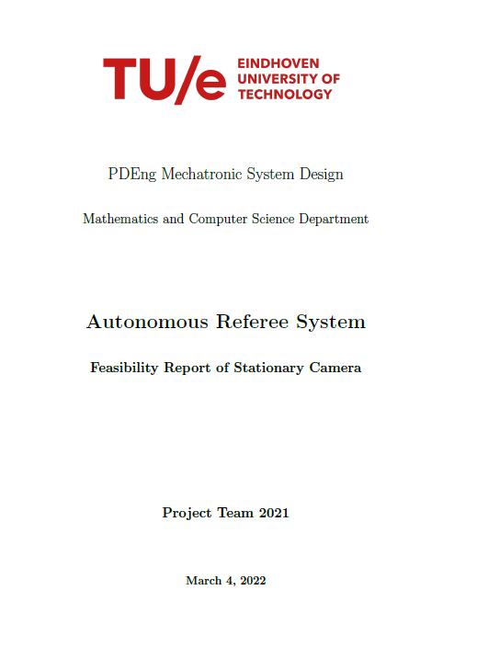
AutoRef - Progress
Deliverables:
Individual reports containing the feasibility analysis of each technology
Drones
Stationary cameras
2020 MSD simulation
Turtles
2o21 MSD AutoRef Project

Slide 5
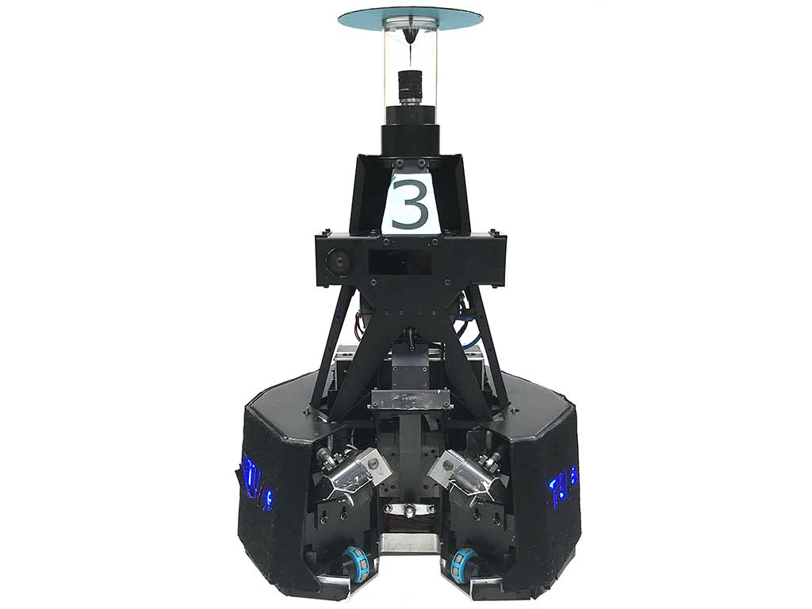
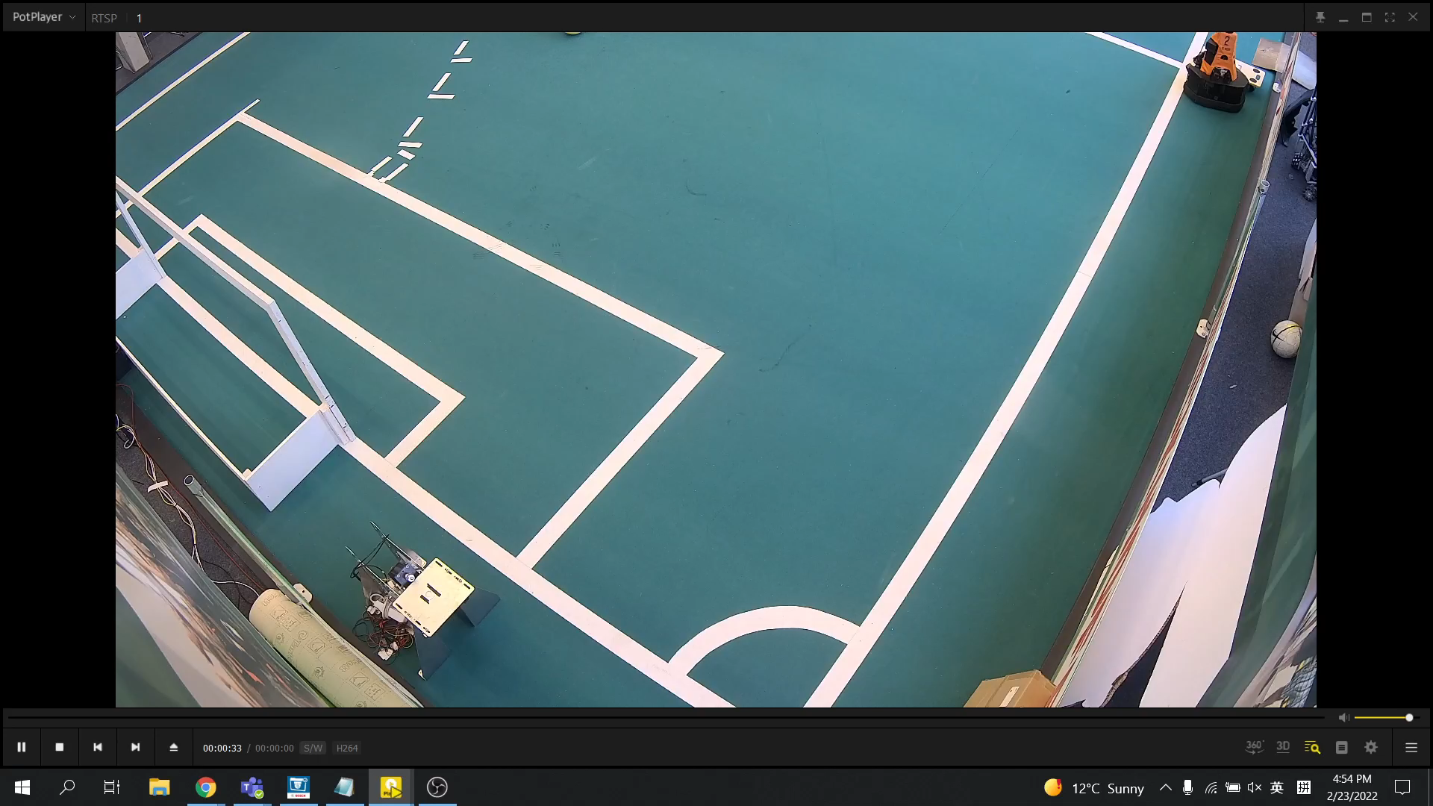
Scope
Use the data from Turtles (players) to identify rules violated by creating offline decision-making algorithms.
Simulate a real match and store all data from all Turtles
Use data collected by Tech United code
Use Refbox algorithm to communicate with Turtles about Start/Stop of the match
Collect evidences for when the rules are violated
Where, when and who
Use of stationary cameras to validate the decision-making algorithm.
Validation
2o21 MSD AutoRef Project

Slide 6
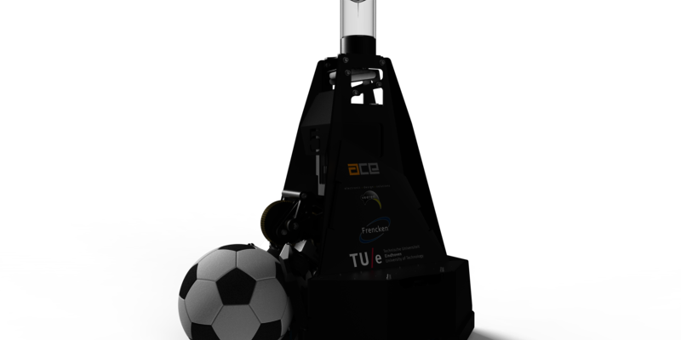
Why use of Turtles?
Reliable hardware and software
Contains all data available to create the decision-making algorithm
Easy interaction with experts (Tech United team)
Representation of a real robot soccer game
First step for a future implementation of an autonomous referee
2o21 MSD AutoRef Project

Slide 7
Data available
Robot position, ball position, team status (attacking/defending) or who passed the ball last.
fieldAreaCoords
Task
Determine if the ball is in play or out of play (rule 9.1 and 92)
getBallPosition
Requirement
Acceptance testing
lastPlayerTouched
Architecture design
Integration testing
Coding
Coding
isBallInsideFieldBoundary
getPlayerPosition
Next tasks to be implemented
Determine if all other players from ball awarded team are >2 m away from ball
Determine if all players from defending team are >3m away from ball
Determine if the ball has rolled freely for >0.5 m after kick (throw in, goal kick, corner, kick off, free kick)
2o21 MSD AutoRef Project

Slide 8
Challenges faced
Tech United code familiarization
Tried to use stationary cameras for validation of the code but frames got corrupted (slow computer processing)
Not possible to find proper documentation for data that is being logged
Workforce away from work for health reasons
2o21 MSD AutoRef Project

Slide 9
Questions
Do we need to present the code in a real game?
Do we need to have half time in 5 min match?
Do we need to have allowance for time lost?
Do we need to have extra time?
Do we need to consider abandoned match?
2o21 MSD AutoRef Project

Slide 10
THANK YOU

